Slide 1


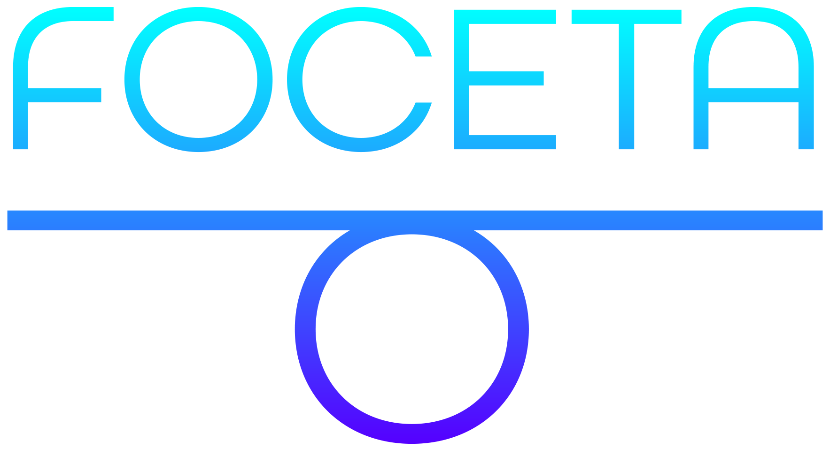

Safety Shielding under Delayed Observation
Filip Cano Córdoba, Alexander Palmisano,
Martin Fränzle, Roderick Bloem, Bettina Könighofer
12 July 2023
This work has received funding from the European Union’s Horizon 2020 research and innovation programme under grant agreement Nº 956123 - FOCETA.
Notes:
Safety of autonomous agents in real-world
One aspect often overlooked
Unexpected safety violations

Slide 2
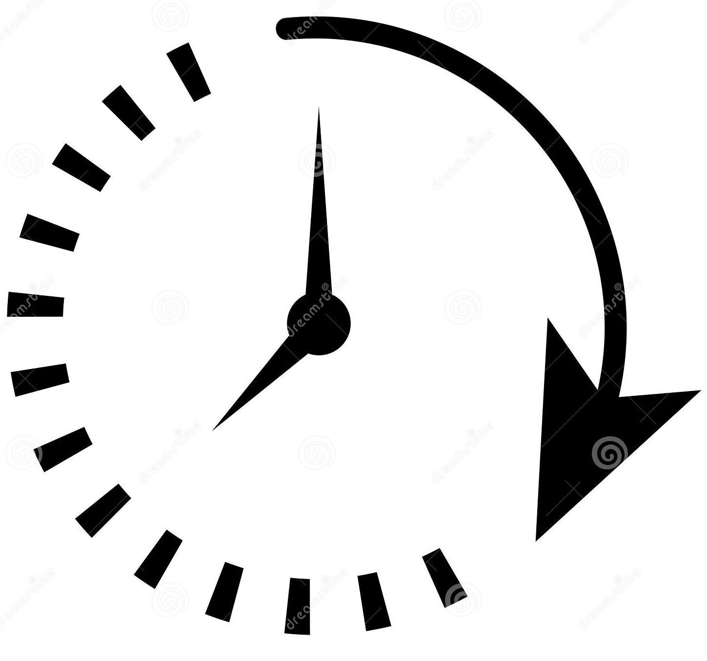


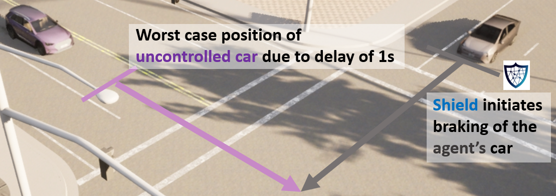
Runtime Safety Enforcement with Shields
Safety Shielding under Delayed Observation Filip Cano Córdoba
Shields guarantee safety, with minimal interference
delayed
observation
Environment
Agent
But information may be delayed.
safe
Contributions
Adapt shield synthesis to work with delayed observations.
First implementation of shielding in car simulator
action
📖 Könighofer et al., Safe Reinforcement Learning via Shielding, AAAI 2018
Notes:
Agent operating in an environment.
Shileds are runtime enforcers
What if delay
In our paper…

Slide 3
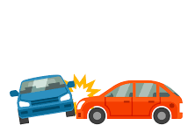
Shield Synthesis - Safety Games
Safety Shielding under Delayed Observation Filip Cano Córdoba
observations
Player
Player
a, b
Environment
Agent
s₆
s₇
actions
b
s₅
a
s₄
s₉
s₁₀
b
b
s₈
a
s₀
s₁
s₂
s₃
a
a
b
📖 Thomas, On the synthesis of strategies in infinite games, STACS 1995
Notes:
Let me give you some insight
Game graph, 2 players, by turns, infinite plays
Blue states belong to the agent
Red states belong to the environment
Bad states
The agent wins…
Shields are built from wining strategy…

Slide 4
Shield Synthesis - Delayed Safety Games
Safety Shielding under Delayed Observation Filip Cano Córdoba
delayed
observations
Player
Player
a, b
Environment
Agent
s₆
s₇
actions
b
s₅
a
s₄
s₉
s₁₀
b
b
s₈
a
s₀
s₁
s₂
s₃
a
a
b
📖 Chen et al., Indecision and delays are the parents of failure. Acta Informatica, 2020
Notes:
Solve the game in delayed mode
In normal mode…
In delayed mode, the agent observes the past, needs to act in the present, planning for the future
We took their algorithm and made if faster

Slide 5
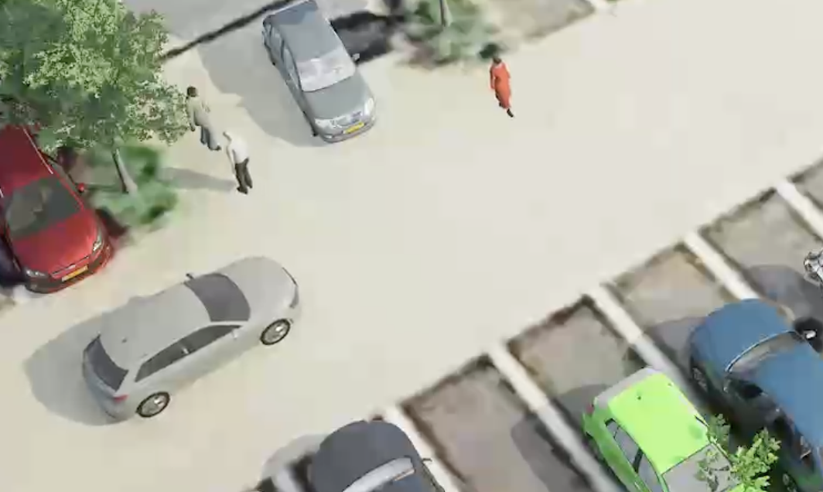
Shielding Against Collisions in Carla
Safety Shielding under Delayed Observation Filip Cano Córdoba
Model of the environment
Ego car velocity.
Relative distances from car to pedestrian: dist_{x} , dist_{y}.
dist_{y}
dist_{x}
Controller
We modified Carla‘s own traffic manager agent.
📖 Dosovitskiy et al., Carla, an Open Urban Driving Simulator, CoRL 2017
Notes:
I promised you some videos…
Only collisions with pedestrians.
Model velocity
Model 2 distances
Carla’s basic controller

Slide 6
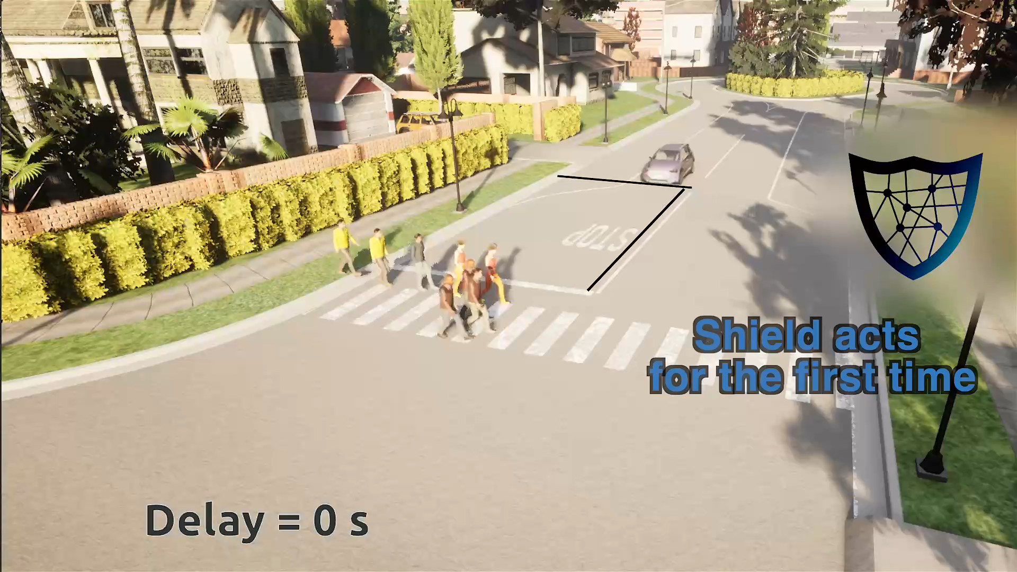
Shielding Against Collisions with Pedestrians in Carla
Safety Shielding under Delayed Observation Filip Cano Córdoba
📖 Dosovitskiy et al., Carla, an Open Urban Driving Simulator, CoRL 2017
Notes:
In the video, a car is driving in the road, the shield icon indicates when the shield is active.
Shield brakes at distance to closest pedestrian
Worst-case assumption of the pedestrian
Tradeoff between resilience and performance

Slide 7

Contributions & Future Work
Safety Shielding under Delayed Observation Filip Cano Córdoba
Contributions
Adapt shield synthesis to work with delayed observations.
First implementation of shielding in car simulator
Future work
Probabilistic models
Continuous-state models
https://github.com/filipcano/safety-shields-delayed
This work has received funding from the European Union’s Horizon 2020 research and innovation programme under grant agreement Nº 956123 - FOCETA.
Notes:
With this I finish my presentation of this paper, that is a step forward in bringing shielding closer to real applications.

